Slide 1
SchemaStudy: A Generative AI Application for Asynchronous Student Learning and Inquiry
We originally presented these slides at the Society for the Advancement of Biological Education Research (SABER) annual meeting in 2024. We designed these slides for use in a professional development workshop helping participants create their own customized version of the Schema Study application. For more information about running the workshop, including a workshop-ready manual, please contact Keefe Reuther, the corresponding author directly (kdreuther@ucsd.edu).
Any pertinent details are included within the speaker notes.
All images are fair-use or owned by the authors with permission to be used under the GPL-3.0 license.
Notes:
Schema Study: A Large Language Model (LLM) Application for Asynchronous Student Learning and Inquiry
Keefe Reuther, Liam O Mueller, Grace Constantian, and Albert Nguyen

Slide 2
Part 1: Introduction!
30 minutes
Notes:
Schema Study: A Large Language Model (LLM) Application for Asynchronous Student Learning and Inquiry
Keefe Reuther, Liam O Mueller, Grace Constantian, and Albert Nguyen
PART 1: Introduction (30 mins) Slides 2-10
SLIDE 2: Introductions and a brief survey to gauge participants' familiarity with GenAI tools (S6. Schema Study - Workshop Survey.docx)
SLIDE 3: Introduction of workshop hosts (if applicable)
SLIDE 4: QR code to electronic version of workshop manual (contact authors) or S2. Schema Study – Installation Manual.docx
SLIDE 5: Workshop learning objectives
SLIDE 6: AI terminology
SLIDE 7: Leveraging LLM’s strengths and weaknesses to improve pedagogy in the classroom.
SLIDE 8-9: Theoretical Framework underlying Schema Study (Cognitive Schema theory)
SLIDE 10: Demonstration of the app after participants have copied the template for themselves.

Slide 3
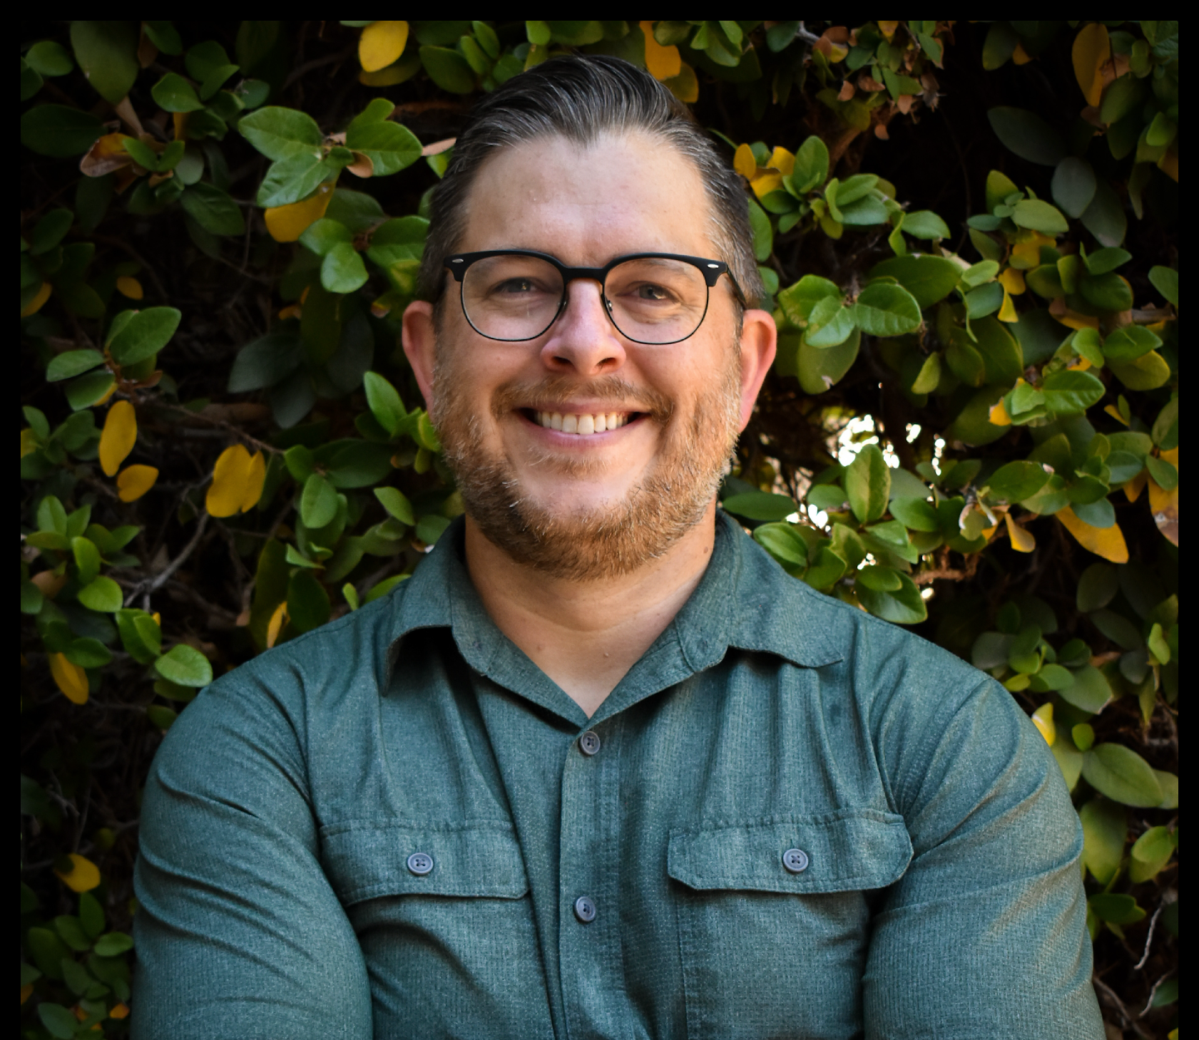
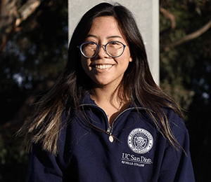
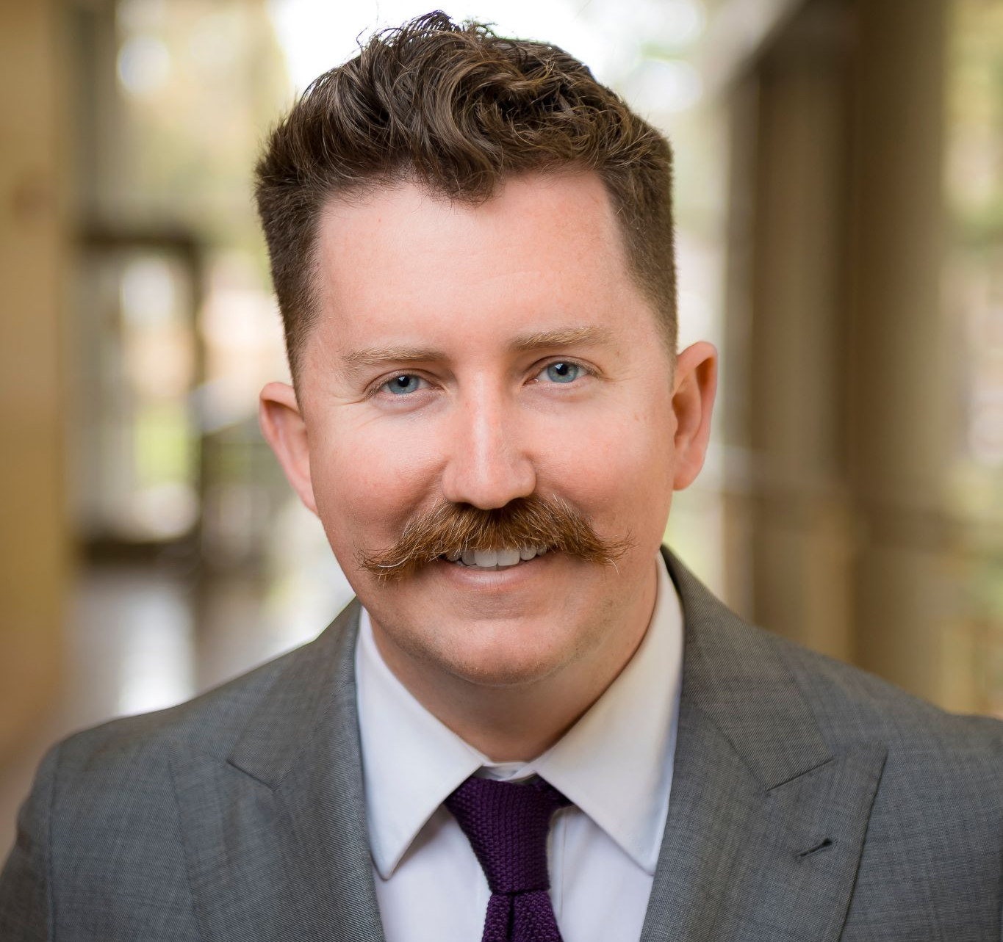

Who are we?
Keefe Reuther
Assistant Teaching Professor
Ecology, Behavior & Evolution
kdreuther@ucsd.edu
Grace Constantian
Undergraduate
UC San Diego
Liam O’Connor Mueller
Assistant Teaching Professor
Molecular Biology
lomueller@ucsd.edu
Albert Nguyen
Undergraduate
UC San Diego
Notes:
Schema Study: A Large Language Model (LLM) Application for Asynchronous Student Learning and Inquiry
Keefe Reuther, Liam O Mueller, Grace Constantian, and Albert Nguyen
SLIDE 3: Introduction of workshop hosts (if applicable)

Slide 4
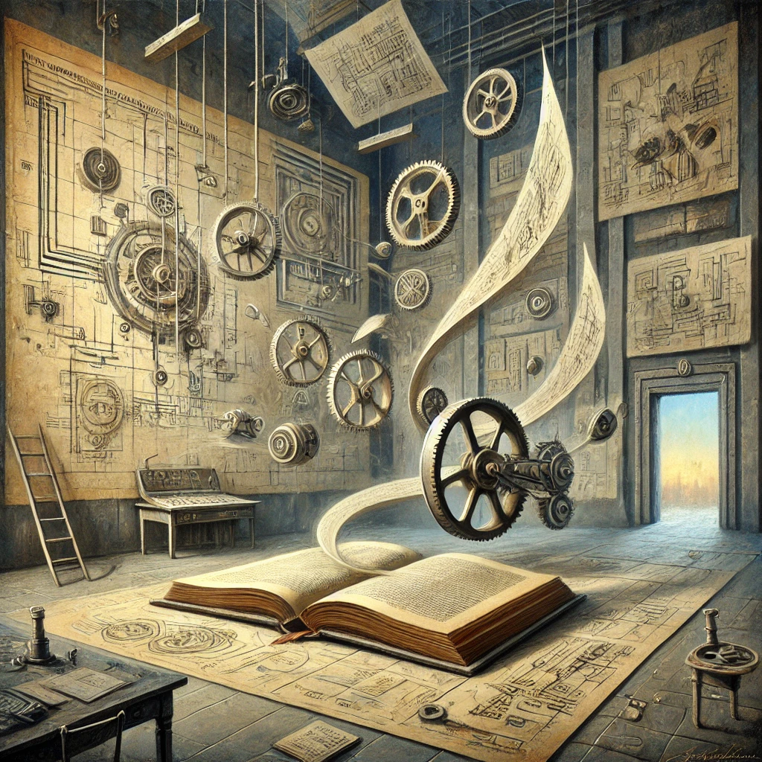
The Workshop Manual
Placeholder for a QR Code
Notes:
Schema Study: A Large Language Model (LLM) Application for Asynchronous Student Learning and Inquiry
Keefe Reuther, Liam O Mueller, Grace Constantian, and Albert Nguyen
SLIDE 4: QR code to electronic version of workshop manual (contact authors) or S2. Schema Study – Installation Manual.docx
Picture is a Chat-GPT DALL-E 3 production from the prompt: “create a square picture of a surrealist painting titled "The Workshop Manual””
Free QR codes can be generated at https://www.adobe.com/express/feature/image/qr-code-generator

Slide 5
What will you leave with today?
A fully functional, open-source web application with GPT-4o your students can use free of charge to interactively study course concepts.
A code-free framework which allows you to modify this app in any way you choose.
An invitation for continued support and collaboration utilizing and experimentally testing generative AI tools.
Notes:
Schema Study: A Large Language Model (LLM) Application for Asynchronous Student Learning and Inquiry
Keefe Reuther, Liam O Mueller, Grace Constantian, and Albert Nguyen
SLIDE 5: Workshop learning objectives
Above is a condensed summary. Here is the full list:
Learning Objectives:
By the end of the workshop, participants will be able to:
Generate a tailored list of 3 biology-specific terms and their schema using effective and iterative GPT-4 prompts.
Use the tailored list to build an interactive study activity that students can use to practice with your terms.
Implement the setup and customization of a web application
Assess the web application's feedback accuracy by conducting simulated student interactions, applying strategies to improve content relevance and pedagogical value.
Propose strategies for integrating AI-enhanced tools into biology education, reflecting on potential impacts, ethical considerations, and future applications in a structured discussion.

Slide 6
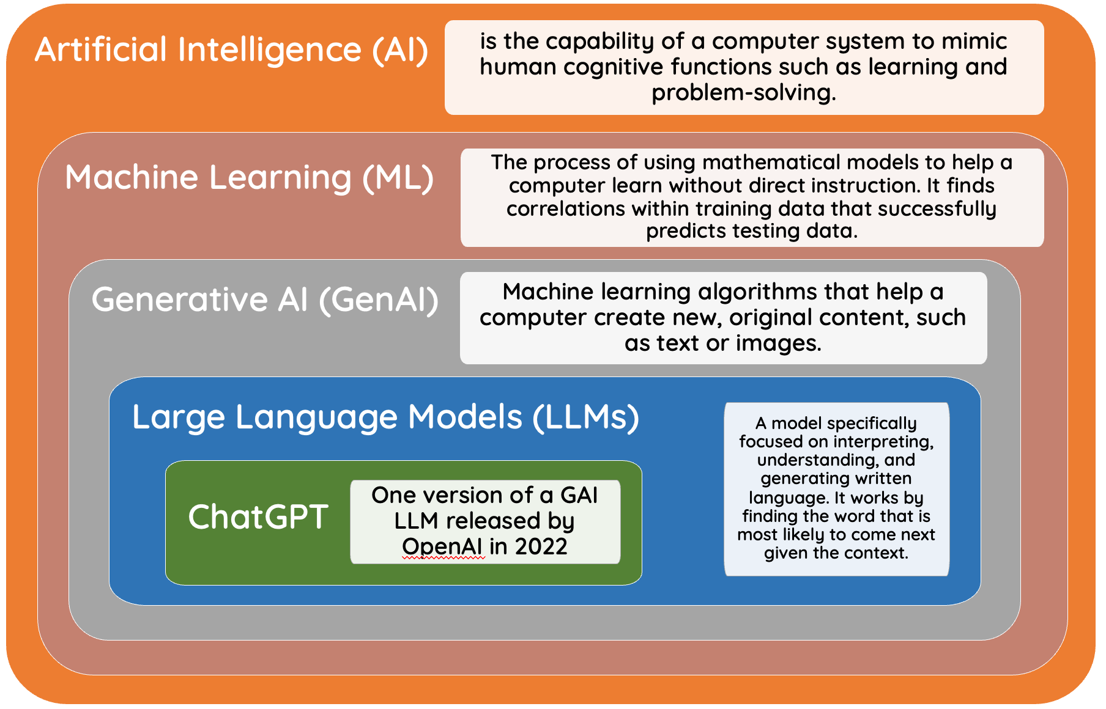
Notes:
Schema Study: A Large Language Model (LLM) Application for Asynchronous Student Learning and Inquiry
Keefe Reuther, Liam O Mueller, Grace Constantian, and Albert Nguyen
SLIDE 6: AI terminology

Slide 7
Leveraging LLMs for better learning
LLMs should add new pedagogy to classes
LLMs can: Give users rapid, specific feedback at scale
Help students master biology content asynchronously
Fill gaps in content understanding
Maximizing Strengths
LLMs should not replace established curriculum
LLMs struggle: Hallucinations, false confidence, off-topic responses
Mastery of critical information literacy
Determine limits of LLMs in biology
Monitoring Weaknesses
Notes:
Schema Study: A Large Language Model (LLM) Application for Asynchronous Student Learning and Inquiry
Keefe Reuther, Liam O Mueller, Grace Constantian, and Albert Nguyen
SLIDE 7: Leveraging LLM’s strengths and weaknesses to improve pedagogy in the classroom. Points to consider.

Slide 8
Cognitive Schema Theory (CST)
A cognitive framework for how we structure and grow knowledge and memory.
A schema is a dynamic and interconnected body of knowledge about a particular thing (e.g., pigeons, genetic drift).
Novice and expert schemata are structured differently.
As educators, we facilitate this journey.
Derry, S. J. (1996). Cognitive schema theory in the constructivist debate. Educational psychologist, 31(3-4), 163-174.
Notes:
Schema Study: A Large Language Model (LLM) Application for Asynchronous Student Learning and Inquiry
Keefe Reuther, Liam O Mueller, Grace Constantian, and Albert Nguyen
SLIDE 8-9: Theoretical Framework underlying Schema Study (Cognitive Schema theory)

Slide 9
Schemata change over time
Novice schema
Smaller
Lacks underlying framework
Weaker connections
Harder to incorporate new knowledge
Expert schema
Larger
Strong framework
Strong connections
Easy to incorporate new knowledge
Notes:
Schema Study: A Large Language Model (LLM) Application for Asynchronous Student Learning and Inquiry
Keefe Reuther, Liam O Mueller, Grace Constantian, and Albert Nguyen
SLIDE 8-9: Theoretical Framework underlying Schema Study (Cognitive Schema theory)

Slide 10
The Schema Study App
Guided intentional practice when human expertise is not available
3am before the midterm
Courses with >100 students
Free for students.
You provide context and constraints.
Notes:
Schema Study: A Large Language Model (LLM) Application for Asynchronous Student Learning and Inquiry
Keefe Reuther, Liam O Mueller, Grace Constantian, and Albert Nguyen
Demo your copy of the app
Replace with a QR code for your version of the app if applicable.

Slide 11
Part 2: Use GPT-4.1 to create a list of course terms for students to study
30 minutes
Notes:
Schema Study: A Large Language Model (LLM) Application for Asynchronous Student Learning and Inquiry
Keefe Reuther, Liam O Mueller, Grace Constantian, and Albert Nguyen
PART 2: Application to their own course of choice - ELO 1 (30 minutes):
Demonstration on how to create a file of terms for their own course iteratively with ChatGPT.
They will download S1. Schema Study - Terms and Context Spreadsheet.csv
Participants will form 2-person teams.
Teams will use ChatGPT to create their own file of terms and definitions.
Aim for 3 terms and schema

Slide 12
Part 3: Building your own online study app
60 minutes
Notes:
Schema Study: A Large Language Model (LLM) Application for Asynchronous Student Learning and Inquiry
Keefe Reuther, Liam O Mueller, Grace Constantian, and Albert Nguyen
PART 3
Using S2. Schema Study – Installation Manual.docx

Slide 13
Part 4: Evaluating your app
45 minutes
Notes:
Schema Study: A Large Language Model (LLM) Application for Asynchronous Student Learning and Inquiry
Keefe Reuther, Liam O Mueller, Grace Constantian, and Albert Nguyen
PART 4: Evaluating - ELO 4 and 5 (45 mins):
Participants will learn strategies to improve the accuracy and completeness of the chatbot’s responses by simulating student use and attempting to elicit wrong or irrelevant information.
Tell participants they can consider adding a grading rubric to the prompt with some example outputs. This would also allow the model to provide an informal grade alongside the feedback.
Walkthrough documentation for this process. Should be along the lines of:
Write a perfect, ok, wrong, and hilariously wrong response in the app and see where the chatbot fails or succeeds
Change the prompt to address that issue.
Rinse and repeat.
Table Discussion: What worked, what didn’t, what surprised you most.

Slide 14
Time to test each other’s apps
Share your url with someone else at your table:
Feed the app both good and poor responses
What happens when you put an incredibly wrong answer in?
Attempt to elicit wrong or irrelevant information
Often the app will catch this early on in the ‘conversation’: try deeper in.
Share your findings with the author
Think about where improvements could be made
Notes:
Schema Study: A Large Language Model (LLM) Application for Asynchronous Student Learning and Inquiry
Keefe Reuther, Liam O Mueller, Grace Constantian, and Albert Nguyen

Slide 15
Part 5: What’s next?
10 minutes
Notes:
Schema Study: A Large Language Model (LLM) Application for Asynchronous Student Learning and Inquiry
Keefe Reuther, Liam O Mueller, Grace Constantian, and Albert Nguyen
PART 5: Wrap-Up - ELO 5 (10 minutes): Pointing them at resources!
Brainstorming ideas in which API’s can be used to create active learning opportunities and issues that should be explored by biology education researchers.
Other ways this app can be transformed to fit your needs.
Example activities and assessments (S4 Schema Study – Student Activities.docx

Slide 16
How else to incorporate into your curriculum?
Beware summative feedback and personal data.
It can be done, but it’s complicated
Have a conversation about academic integrity and generative AI limitations.
Great for discussion board assignments, and low stakes assessments.
A low-pressure space for intellectual creativity and play.
An opportunity to practice scientific literacy skills.
Notes:
Schema Study: A Large Language Model (LLM) Application for Asynchronous Student Learning and Inquiry
Keefe Reuther, Liam O Mueller, Grace Constantian, and Albert Nguyen
PART 5: Wrap-Up - ELO 5 (10 minutes): Pointing them at resources!
Brainstorming ideas in which API’s can be used to create active learning opportunities and issues that should be explored by biology education researchers.
Other ways this app can be transformed to fit your needs.

